Slide 1
Introduction to Robot Safety: What You Need to Know About Robotics & Safety Standards
Boyi Hu, Ph.D.
Assistant Professor

Slide 2
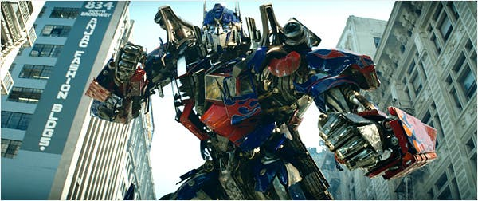
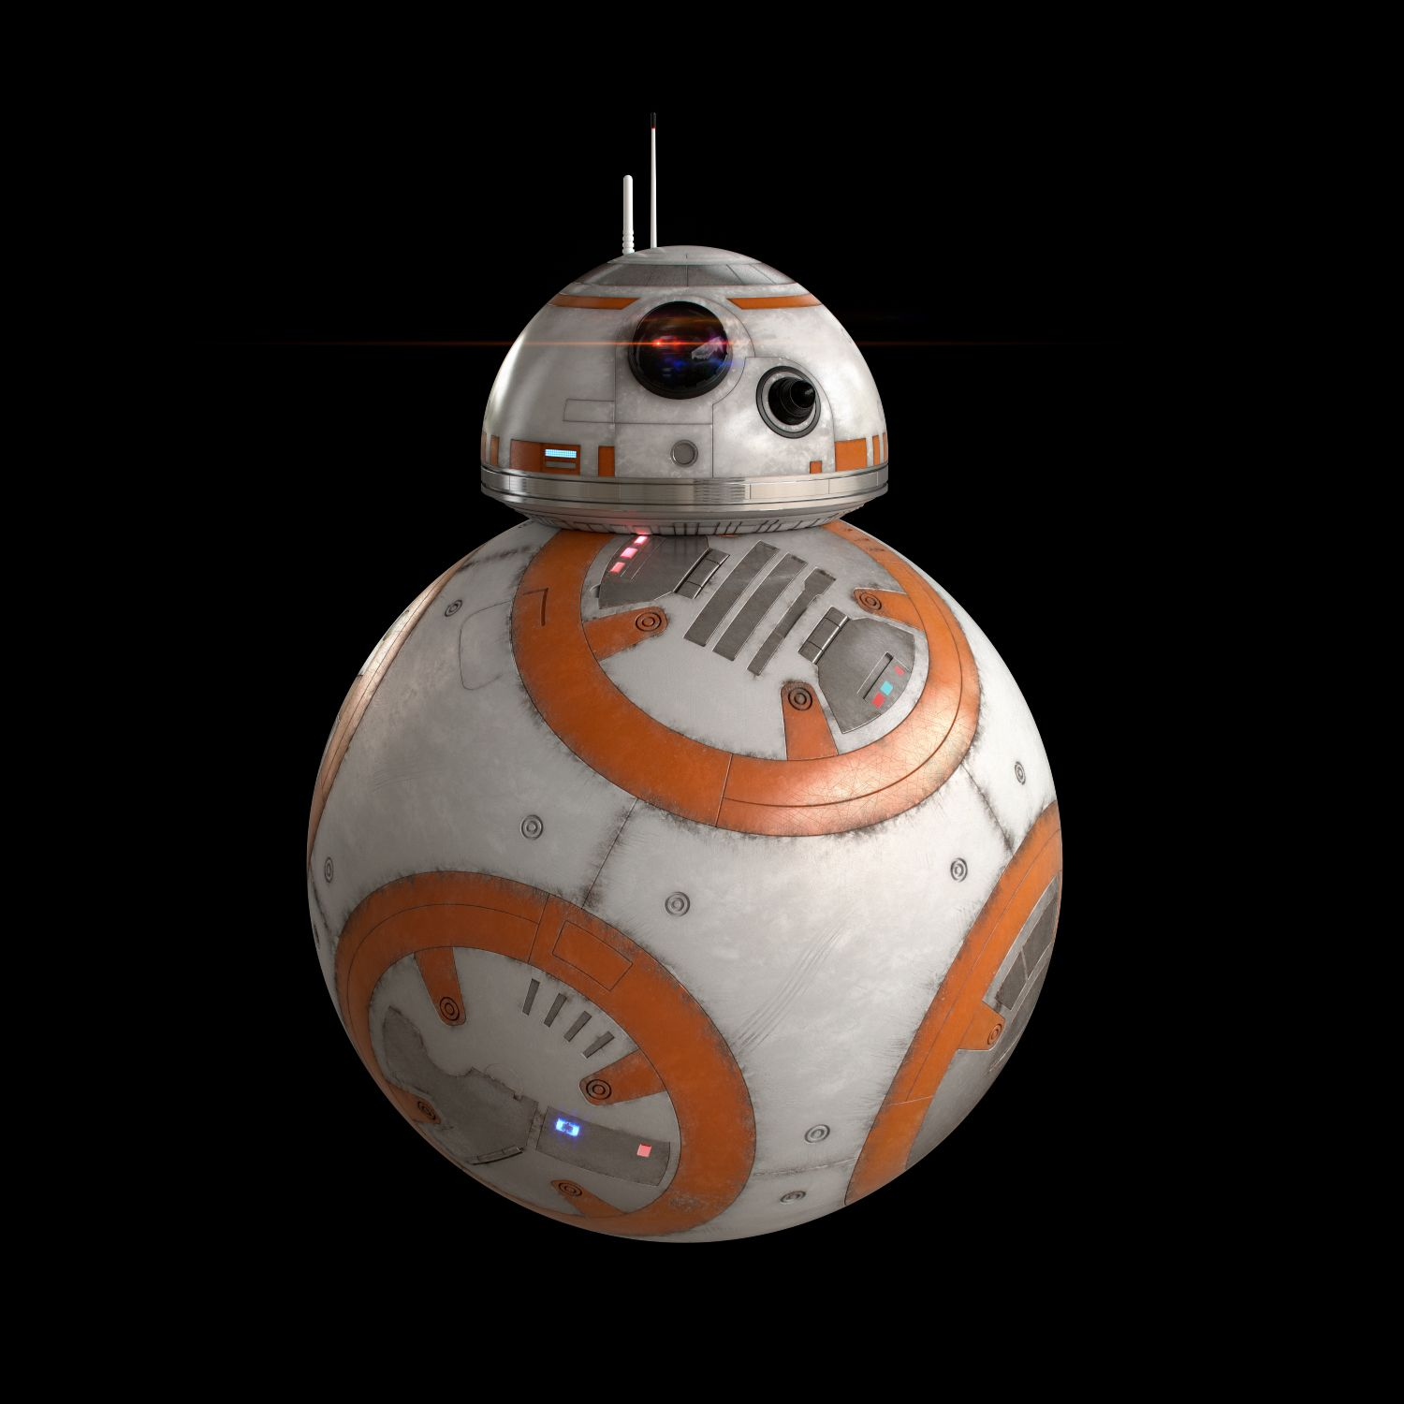
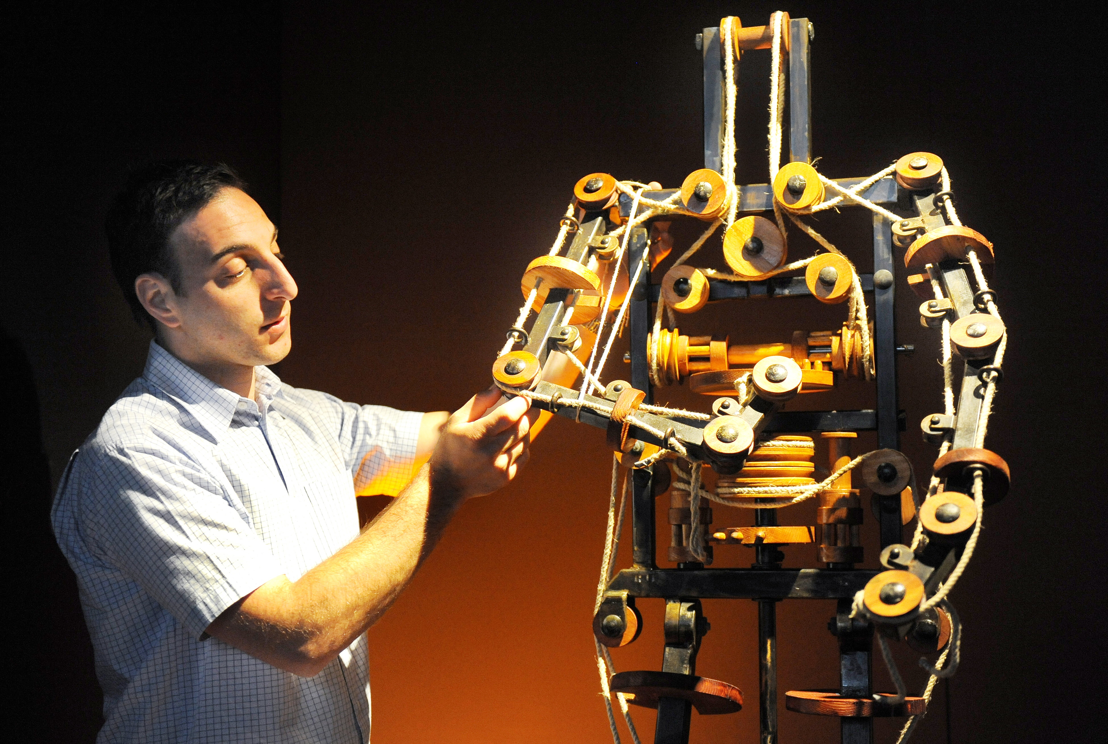
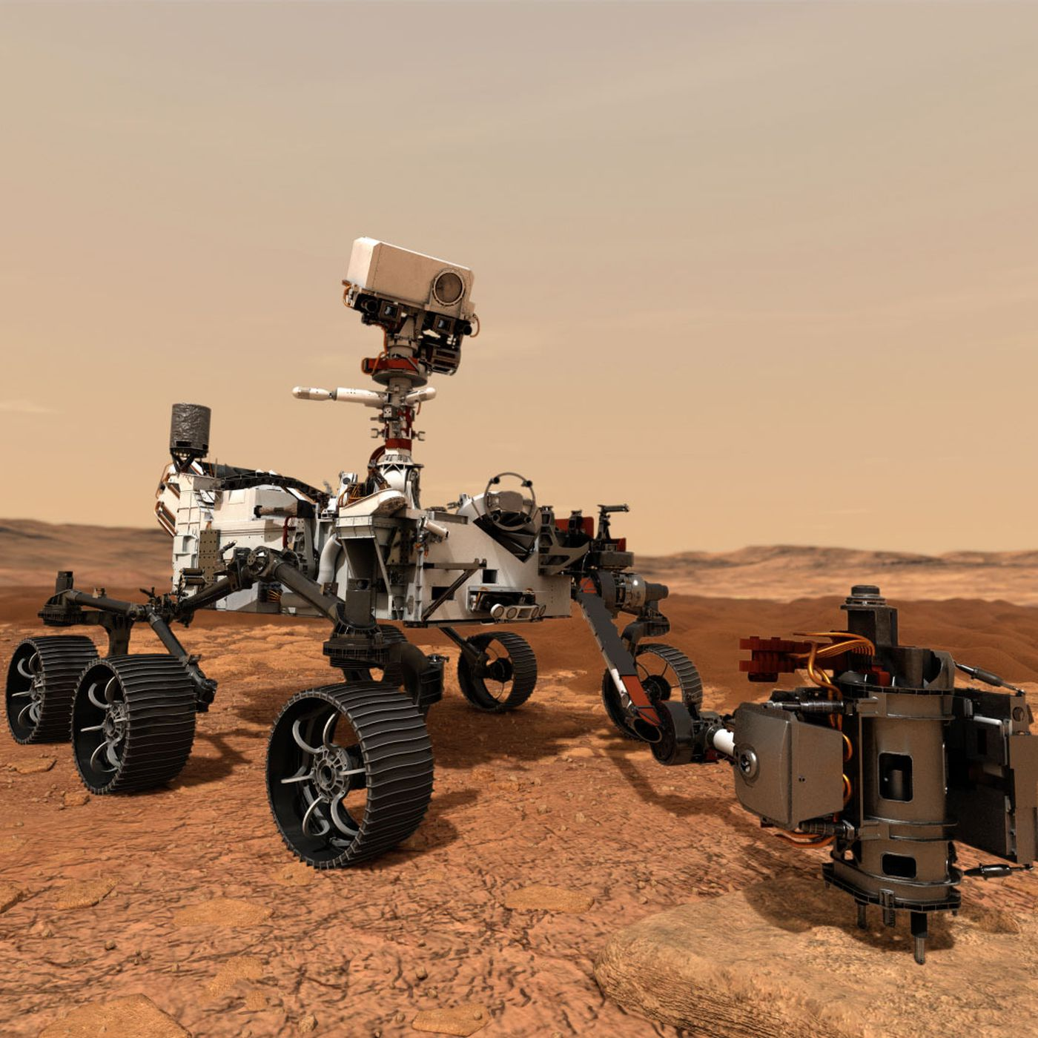
Remember this, or this or this…

Slide 3
Robots are …
NOT from the future
NOT beings of free will
NOT yet capable of complying with Asimov’s 3 Laws:
1. A robot may not injure a human being or, through inaction, allow a human being to come to harm
2. A robot must obey orders given it by human beings except where such orders would conflict with the first law
3. A robot must protect its own existence as long as such protection does not conflict with the First or Second laws

Slide 4
Let’s be realistic & talk about NOW!
Robots are automated machinery
There are NO emotions
There are no arbitrary motions or actions – they only respond to
Their programs
The state (on, off, high, low) of their inputs
Interference (cybersecurity, EMI, RFI, power fluctuations)
Keep in mind that interferences risks are lessened due to design

Slide 5
Let’s be realistic & talk about NOW!
They are programmed to perform tasks
Some programming requires a high degree of technical skills, as in ‘coding’ skills – real computer-language type skills
Some are easier to program because the difficulty or complexity is ‘under the hood’

Slide 6
Motivational statistics – for healthcare
Healthcare in the US comprises 18% of the GDP, larger than any other sector of the economy.
In-patient care accounts for 1/3 of the total, ~ $1 trillion
Highly labor intensive, 12% of the US workforce directly employed (related industries excluded, such as medical device manufacturers)
20% of the world’s population has a motor, cognitive or sensory impairment

Slide 7
Motivational statistics
Robotics is poised to have even larger transformational impacts
1 million robotics minimally invasive surgical procedures each year, annual increase of 18%
MIT-Manus
Lokomat
Proficio
Etc.

Slide 8

Motivational statistics
The population of US continues to age
In 2030, 21% will be 65+, as opposed to 15% in 2018
In 2060, 25% will be over 65

Slide 9
What is an industrial robot?
Automatically controlled, reprogrammable (key difference from industrial automation)
Multi-purpose manipulator
Programmable in 3 or more axes
Fixed in place or fixed to a mobile platform
For use in automation application in an industrial environment

Slide 10
What is an industrial robot?
Workplace where the public is restricted from access or not reasonably expected to be present for the interested tasks and robot applications
Includes manufacturing, laboratory automation/ production, pharmaceutical automation/ production, palletizing, warehousing, logistic and more

Slide 11

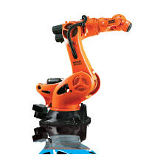
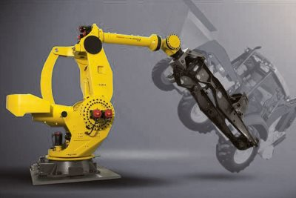
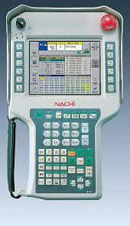
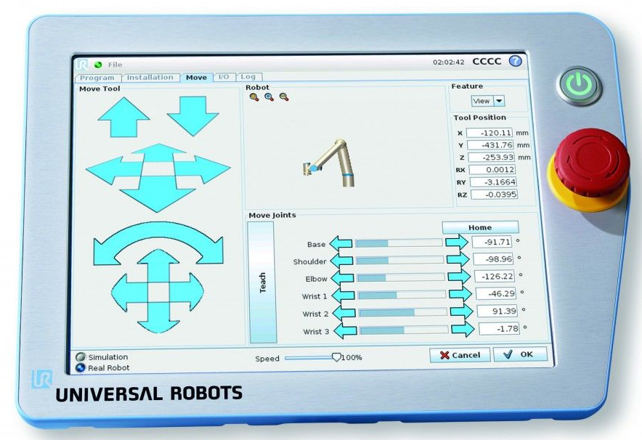
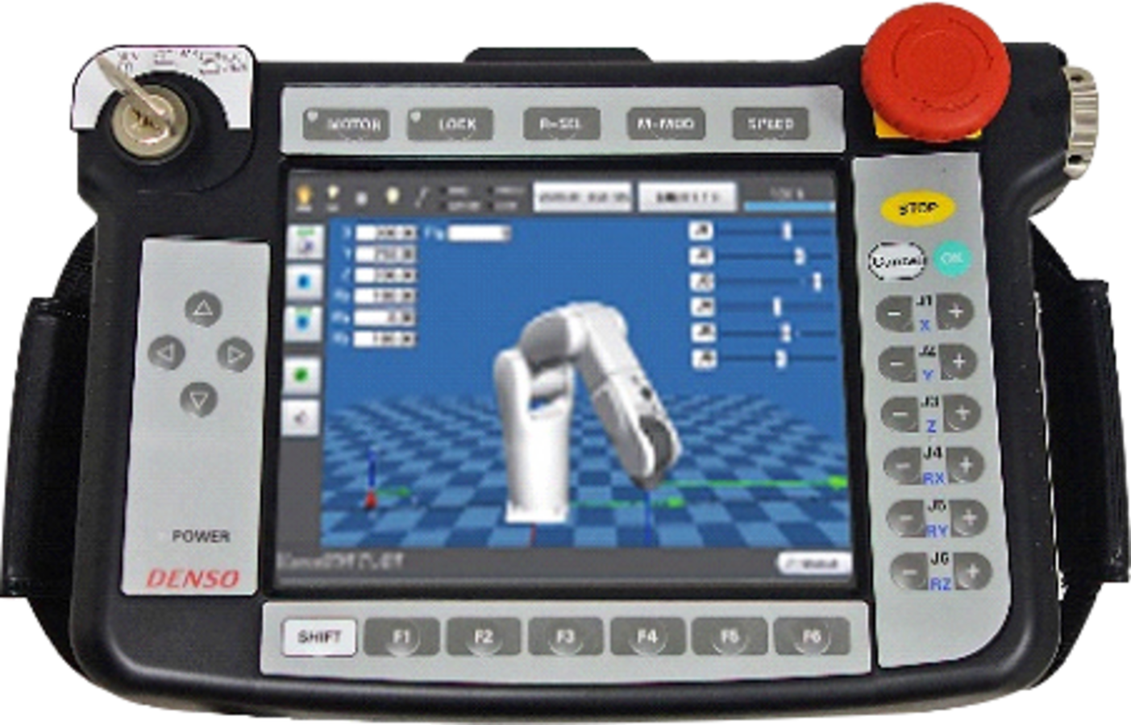
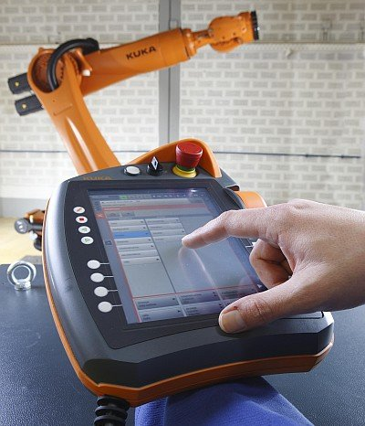
Industrial Robots

Slide 12
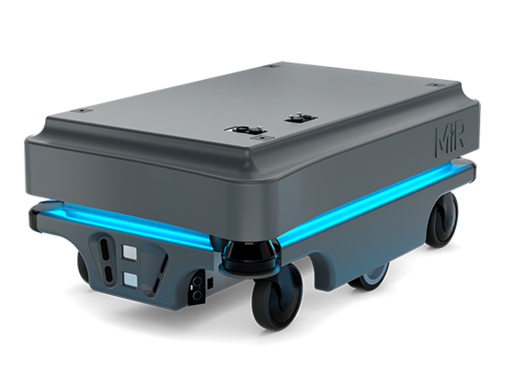
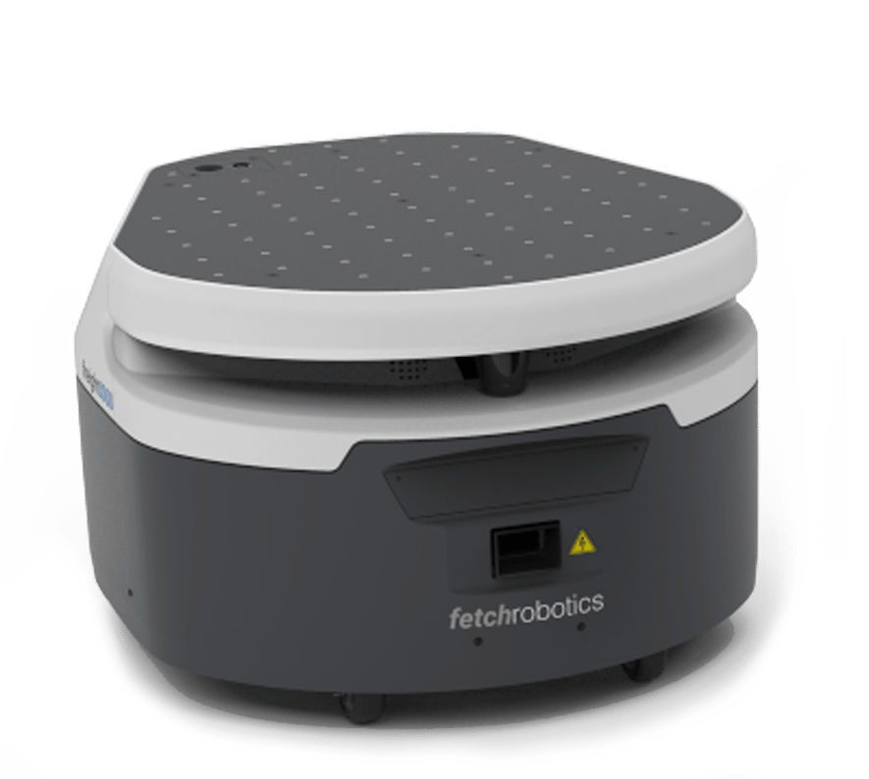
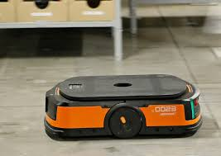
Are there other robots?
Mobile robots – in industrial environments… wheels, tracks, legs…
Service robots – homes, public …
Medical robots, surgery, rehab

Slide 13
Terminology for INDUSTRIAL robotics…
Robot: Robot manipulator & robot control
Robot System: Robot, end-effector
Robot Application: Robot system, workpiece + …
End-effector
What is being done is the application!
Robot (control not shown)

Slide 14
Who is addressed by robot safety standards?
WHO | ANSI | ISO | OSHA | EU
Manufacturer | x | x |  | x
Integrator | x | x |  | x
User | x |  | x

Slide 15
ISO/TS 15066:2016
ISO Technical Specification (TS) 15066:2016 – Collaborative Robots
Provides safety requirements for collaborative industrial robot applications
Supplemental to ISO 10218-1 & -2
Assumes the robot system complies with Part 1 and Part 2 of ISO 10218
Adopted nationally as RIA TR R15.606

Slide 16
Supplemental Safety Documents
Topic | ISO | ANSI
Collaborative… | ISO/TS 15066 | RIA TR R15.606
End-effectors | ISO/TR 20218-1 | To become a RIA TR
Manual load | ISO/TR 20218-2 | To become a RIA TR

Slide 17
Supplemental Safety Documents
Topic | ISO | ANSI
Risk assessment | ISO 12100, ISO 14121-2 | RIA TR R15.306
Safeguarding | ISO 13854, ISO 13856, ISO 13857, ISO 14119 | RIA TR R15.406
Applicability | Not addressed | RIA TR R15.506
User guidance | Not addressed | RIA TR R15.706
Pressure of measurement | In next version of ISO 10218-2 | RIA TR R15.806

Slide 18
Terms | Explanation
Robot | Robot manipulator & robot control (NO end effector, NO workpiece). Robot CAD files do NOT include tooling or parts. Can be fixed in place or mobile
Robot System | Robot, end effector and any task equipment
Robot Cell | Robot System and safeguarding
Reduced speed | Used in manual (reduced speed) mode
Protective Stop | Purpose: protection of people (Different from Estop)
Manual Mode | Reduced speed T1: 250mm/sec or less High speed T2: greater than 250mm/sec
Operator(s) | All personnel, not simply production operators Maintenance, troubleshooting, setup, production

Slide 19
Standard ‘Special’ words
Shall – Normative or mandatory requirement
Should – Recommendation or good practice
May – Permissive or allowed
Can – Possible or capable – statement of fact
Notes: they are informative and provide added information or explain concepts

Slide 20
Industrial Mobile Robot (IMR) – R15.08
3.13.1 (R15.08 Part 1, Clause 3) IMR, Type A:
Industrial autonomous mobile robot with no attachments; one type of mobile platform
3.13.2 IMR, Type B:
AMR with attachments that may be passive or active, but are not manipulators
3.13.3 IMR, Type C:
Mobile platform with manipulator attachment
1

Slide 21
START
N
Industrial Application?
Y
N
Mobile Platform?
N
Manipulator (3+ axis)?
Y
Autonomous
Manual
Y
Navigation?
Autonomous Mobile Robot (AMR)
Guided
No
Manipulator
Automated Guided Vehicle (AGV)
Attachment Type?
Other
Manipulator
No
Attachment Type?
IMR Type A
IMR Type B
IMR Type C
Other
Industrial Mobile Robot
ANSI/RIA R15.08
Automated Guided Vehicle (AGV)
ANSI/TSDF B56.5
Industrial Robot (System)
ANSI/RIA R15.06
END

Slide 22
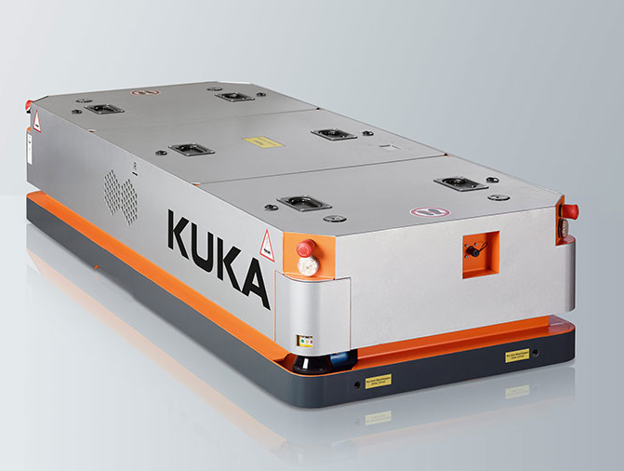
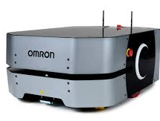
IMR Type A – Industrial AMR
AMR Type A: Autonomous mobile robot (AMR); no attachment(s).

Slide 23

IMR Type A – Industrial AMR
Key Characteristic: Autonomous navigation and mobility
Must it have wheels?
No. The ANSI standard is silent on the mode of mobility
What if it has a tow hook?
Then it is an IMR Type B: ANY capability BEYOND autonomous navigation and mobility

Slide 24
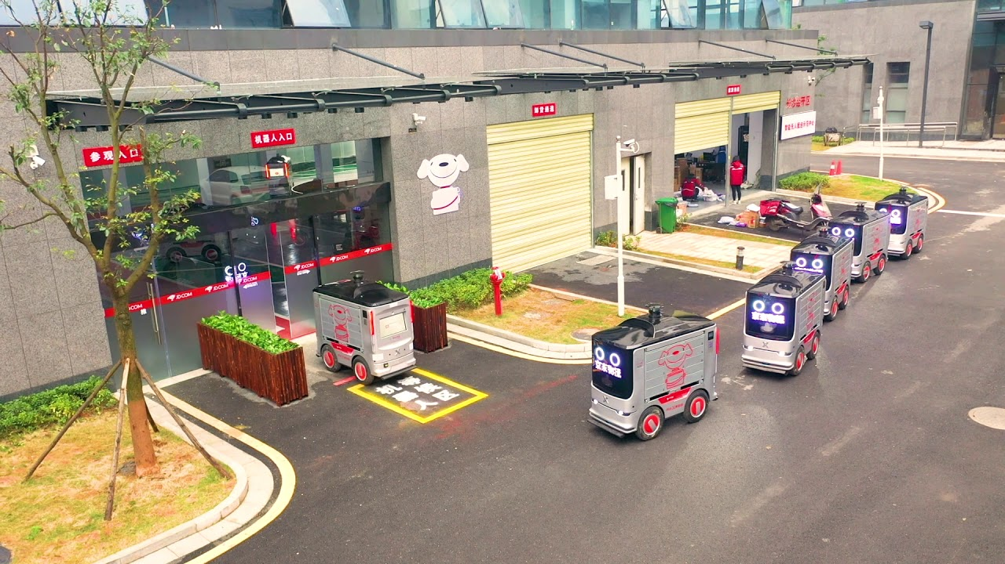
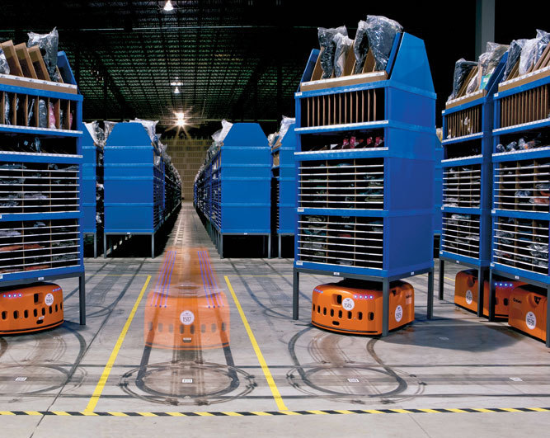
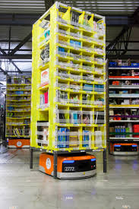
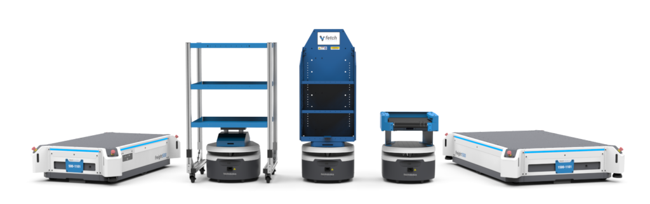
IMR Type B – AMR with Attachments

Slide 25
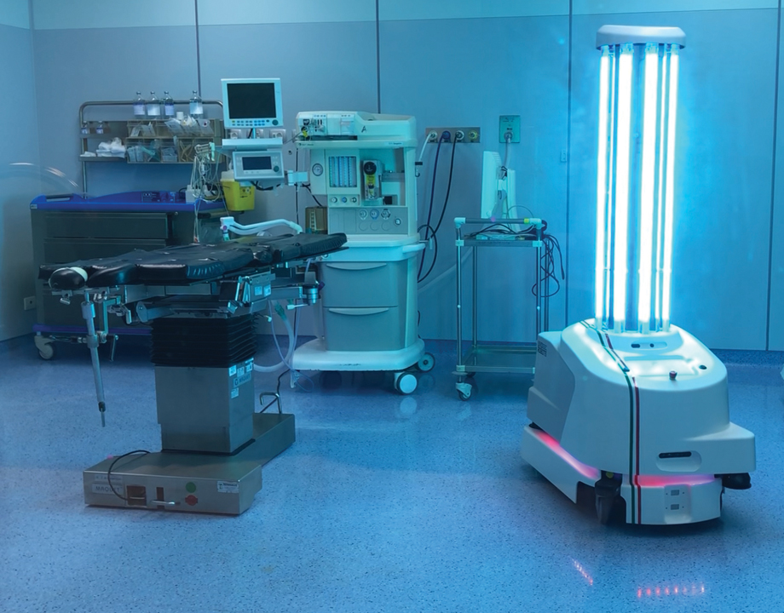
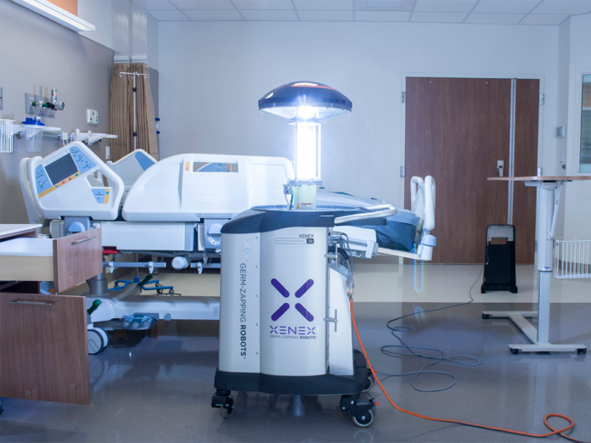
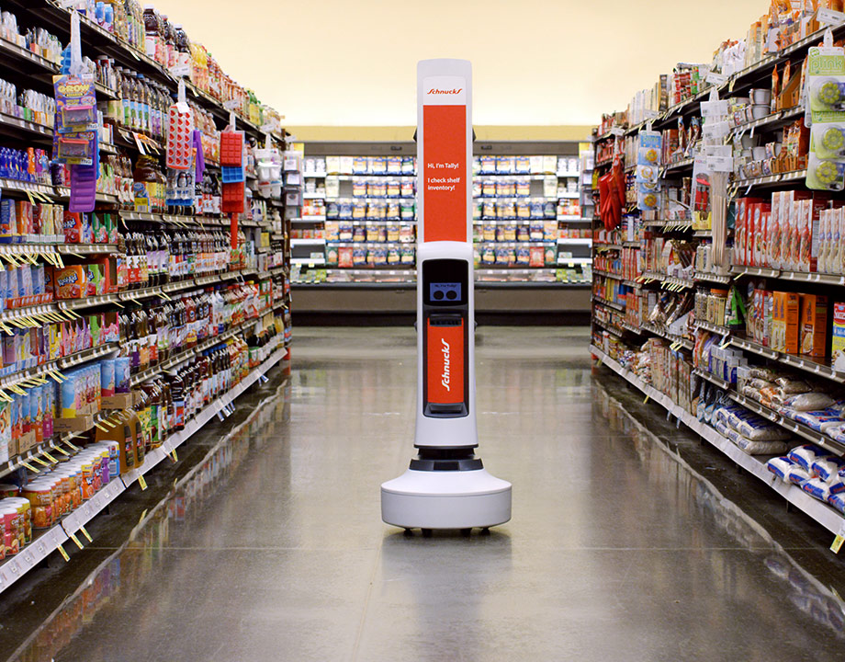
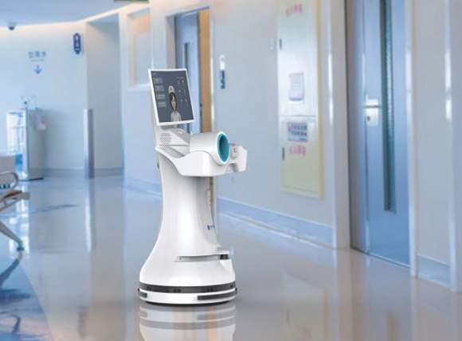
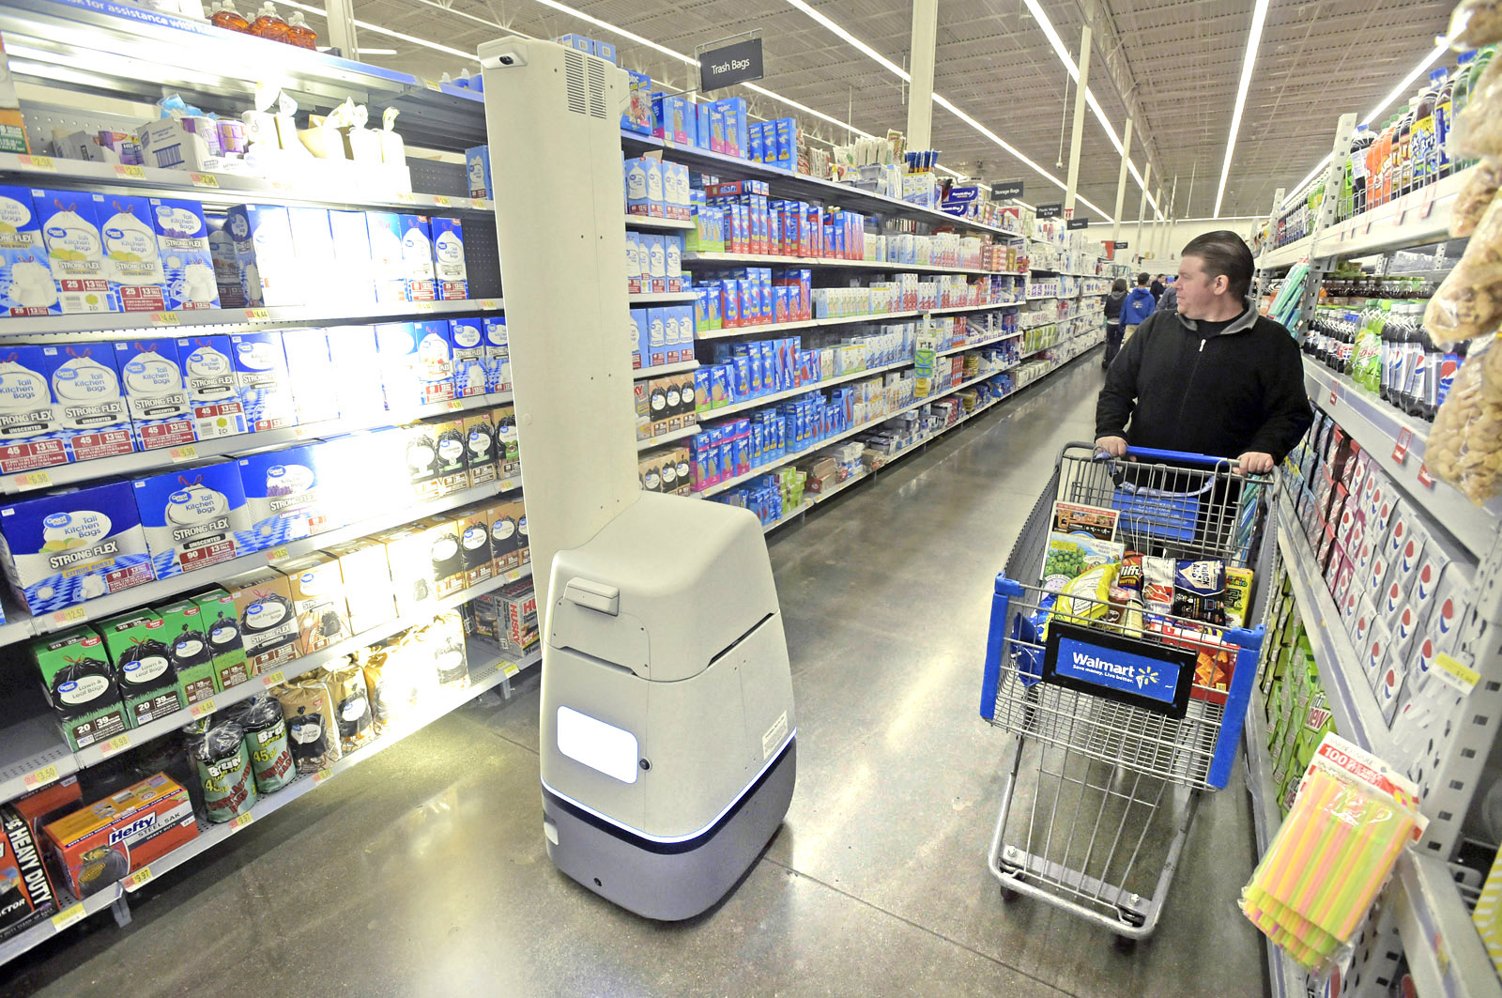
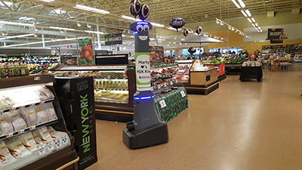
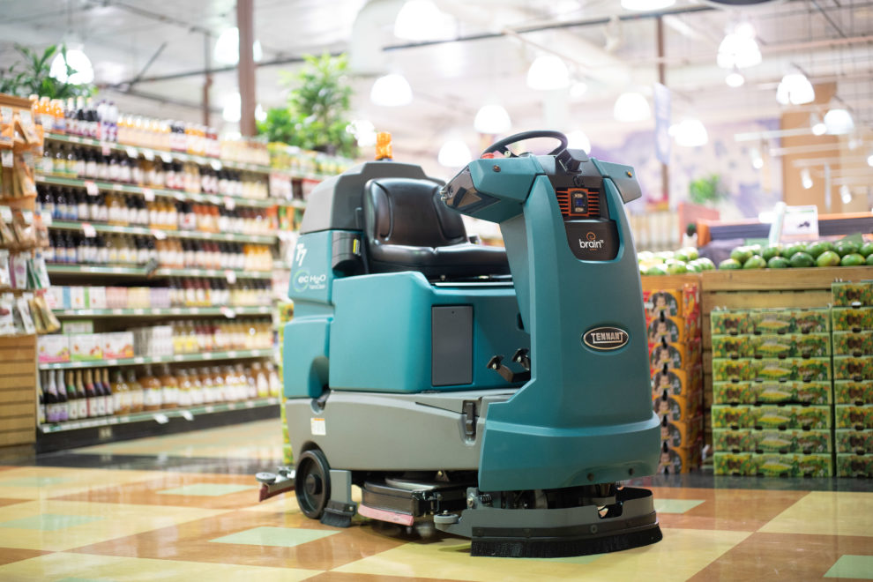
IMR Type B – AMR with Attachments

Slide 26
IMR Type B – AMR with Attachments
Autonomous navigation and mobility PLUS an Attachment (that is NOT a manipulator)
ANY capability BEYOND autonomous navigation and mobility
… EXCEPT for a manipulator (robot arm) (that would make it a Type C)

Slide 27
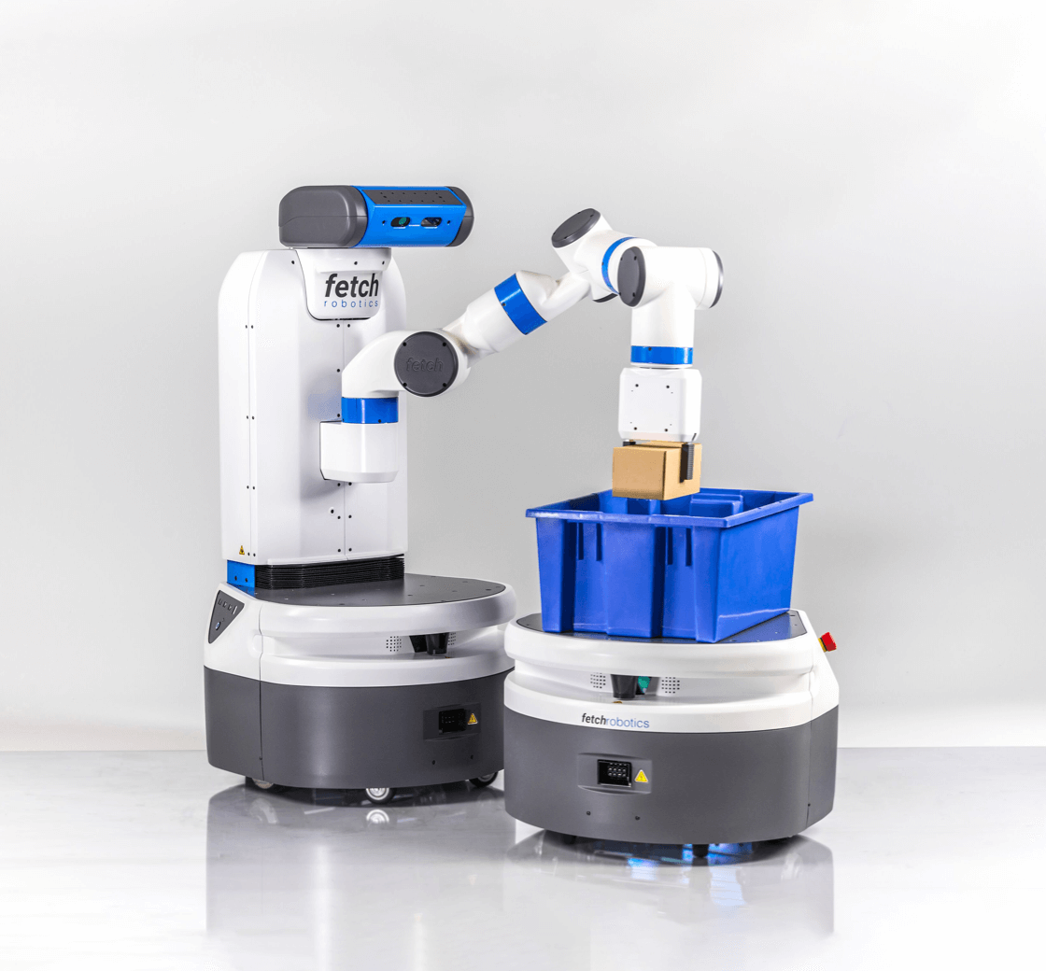
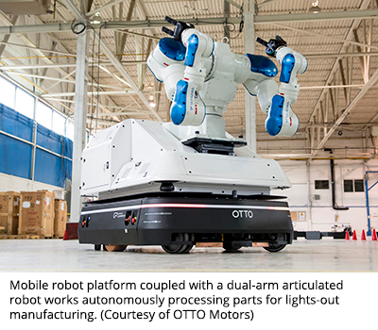
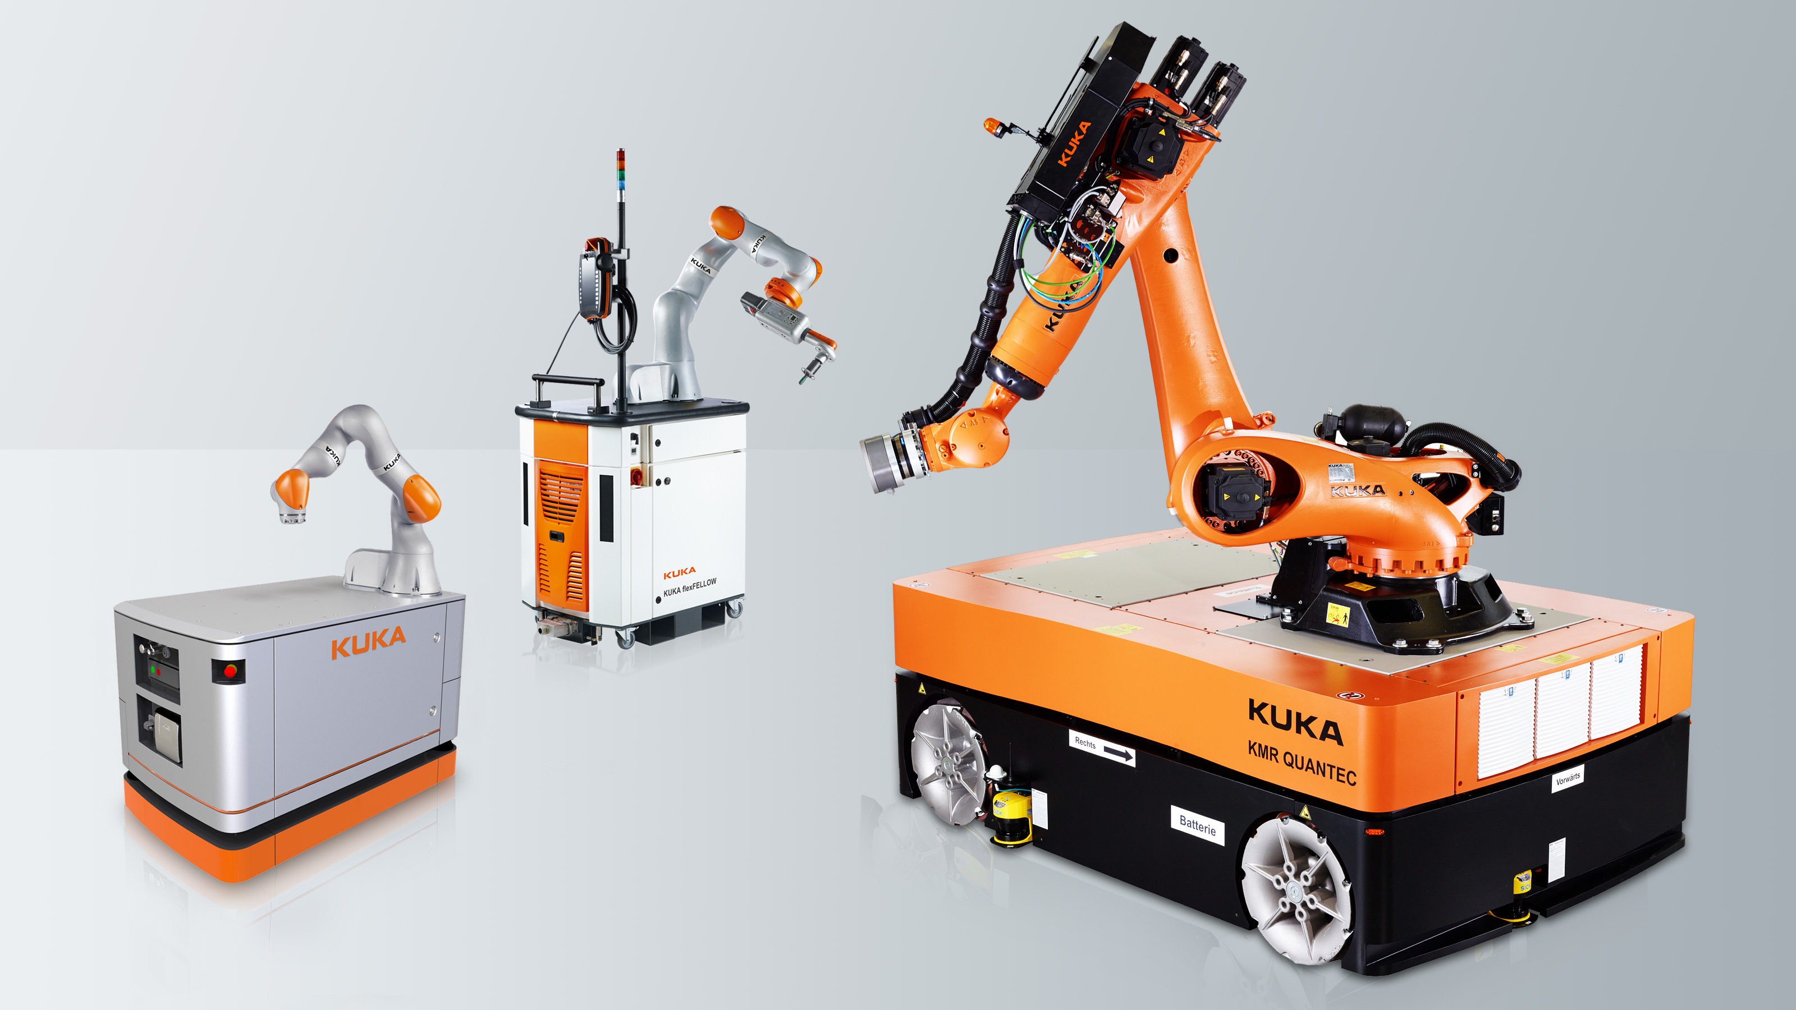
IMR Type C – Mobile Manipulator

Slide 28
IMR Type C – Mobile Manipulators
Key Characteristic: Autonomous navigation and mobility PLUS a manipulator (robot arm)
What if it has 2 manipulators?
Still a Type C; at least 1 manipulator
What if it has some other attachment(s) in addition to the manipulator, e.g., how hook?
Still a Type C

Slide 29
NOT IMRs
AGV without a manipulator as its Attachment
Fork Trucks (including autonomous fork trucks)
AGV with ANY other attachments, so long as they are NOT manipulators (robot arms)
See B56.5 for safety requirements for these machines
Manipulator (robot arm; ‘industrial robot’ per R15.06) if it is fixed in place while operating in automatic mode
This includes when being moved by a mobile platform IF stowed a unpowered (payload) during transport
See R15.06 for safety requirements for these machines

Slide 30
Industrial Robotics Applications
Boston Dynamics 1
Boston Dynamics 2
Amazon smart warehouse (2 min version)
Amazon smart warehouse (10 min version)
AGV vs AMR
Automatic loading system (3 min)
Construction robotics (8 min)

